Slide 1
Bootstrap and MVC
St. Louis Days of .NET 2015

Slide 2
Introduction
Setup
Validation
Helpers
Templates
Themes
Third Party Resources
Scott Kuhl Technology Lead @ U.S. Bancorp Community Development Corp.
@scottkuhl
scott@kuhl.ws
http://1drv.ms/1LNDIqL
Notes:
1 - Introduce yourself.
2 – Slides and code available online. This link will be up again at the end.
3 – 8 - Briefly explain each bullet point.
Techniques are also valid for other frameworks such as Foundation or even a home grown solution, what I am going to show is how to integrate your server side MVC with a front end CSS framework.
During this presentation I will mostly be using slides since we only have an hour, but I will be digging into code, its not just high level information.

Slide 3
Setup
Added by default
NuGet
Other: Bower, npm, Composer, CDN, etc.
Sample = Extend Contoso University
Getting Started with Entity Framework 6 Code First using MVC 5
http://www.asp.net > Learn > Entity Framework > MVC Tutorials
/Views/Student/Create.cshtml
Notes:
1 – Multiple ways to add Bootstrap. (New Project > Templates > Visual C# > Web > ASP.NET Web Application)
I chose Bootstrap to show how to extend a front end framework because of #1, its built into ASP.NET defaults.
2 – Sample. Updating student create view unless otherwise noted.

Slide 4
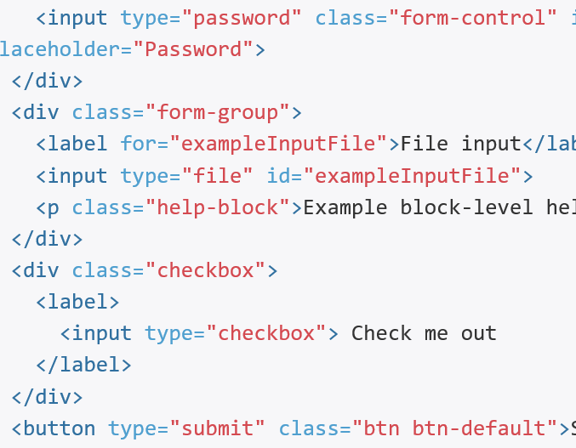
Setup - CSS
/Content/bootstrap.css
Class based
Few HTML defaults
Biggest MVC integration hurdle
Notes:
1 – Bootstrap styles are in the bootstrap.css in the content folder. This is the heart of bootstrap.
2 – This code shows some typical markup you add for Bootstrrap:
- form-control on the password input
- form-group on a div wrapper around multiple input elements
- help-block on a paragraph
- checkbox on a div wrapper
- btn and btn-default on the submit button
That’s a lot of bootstrap classes in a small block of HTML
3 – What are seeing is a CSS class based system that extends HTML to make Bootstrap work. Bootstrap has few HTML defaults which is what will be your biggest hurdle when integrating into MVC. Instead of adding all these classes manually we are going to look at techniques to make it easier.

Slide 5
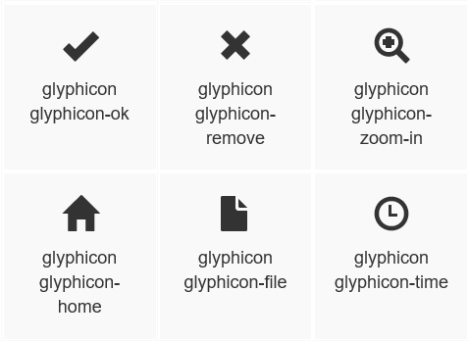

Setup - Icons
/fonts/glyphicons-halflings-regular
250+ Free glyphs
Notes:
1 – Bootstrap includes 250 icons as a font to make them easy to scale to various resolutions.
2 – They have two classes you apply. Glyphicon and glyphicon-{name}
3 – This is an example of how add an icon to the button.

Slide 6
Setup - Scripts
/Scripts/bootstrap.js
jQuery Plugins
No fallback
Data Attributes | <button id=“x” … data-dismiss=“alert”>
API | $(‘#x’).alert()
Events | $(‘#x’).on(‘closed.bs.alert’, function() { …. }
Notes:
1 – Bootstrap also includes JavaScript components are in the bootstrap.js file in the scripts folder.
2 – Implemented as jQuery Plugins.
3 - IMPORTANT, there is no fallback for browsers that do not have JavaScript enabled. If that’s an issue, you should avoid using the JavaScript plugins but you can still use the rest of the CSS found in Bootstrap.
4 –3 ways to interact with these JavaScript plugins, this example shows the Alert component.
- Data Attributes on HTML elements. (declaring the alert)
- jQuery API from JavaScript (alternate way to declare the alert)
- jQuery events (respond to the alert beging closed)

Slide 7
Validation
Setup
Validation
Helpers
Templates
Themes
Third Party Resources
Notes:
So now we are setup and running.
The first change we are going to make is validation. It’s an easy application wide change to get MVCs and Bootstraps validation in sync.

Slide 8
Validation
MVC
Bootstrap
Red Border
Site.css
Input Element
.input-validation-error
Bold + Red Border
Bootstrap.css
Parent Element
.has-error
Notes:
MVC and Bootstrap handle validation differently.
1 – MVC method.
- Applies a red border to the invalid element.
- Styling is added to Site.css in the default template.
- The style is applied to the input element that is invalid.
- Adds the class input-validation-error
2 – Bootstrap method.
Applies a BOLD red border to the invalid element.
Styling is in the bootstrap.css file with the rest of bootstraps styling.
The style is applied to the parent element, not the input element.
Adds the class has-error

Slide 9
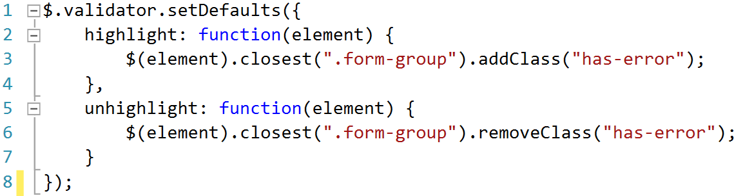
Validation
/Scripts/contoso.validation.js
Notes:
Create a new validation script file, here I use contoso.validation.js.
Updating the jQuery validation by changing the way highlighting works.
Get the invalid element.
Find its parent element.
Add or remove the Bootstrap has-error class.

Slide 10
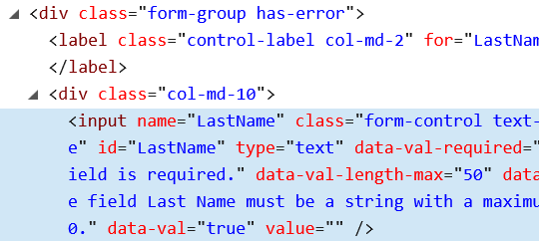
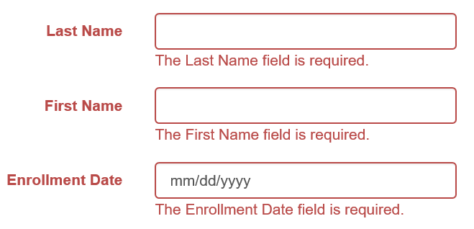
Validation
Notes:
1 – This is what the output will look like on invalid elements. It’s applied application wide to all invalid input.
2 – Here you can see the input element that is invalid, and the resulting parent element with an error class applied.

Slide 11
Validation
Setup
Validation
Helpers
Templates
Themes
Third Party Resources
Notes:
Next we are going to talk about helpers. This is where we will be spending the majority of our time

Slide 12
Helpers – Editor Templates
MVC
BOOTSTRAP
@Html.EditorFor(model => model.FirstName)
<input type=“text” name=“FirstName” id=“FirstName” data-val-required=“The First Name field is required.” data-val=“true” class=“text-box single-line”>
@Html.EditorFor(model => model.FirstName)
<input type=“text” name=“FirstName” id=“FirstName” data-val-required=“The First Name field is required.” data-val=“true” class=“form-control”>
Notes:
MVC has a feature called editor templates. It allows you to override the default markup that is created by MVC based on the data type that is being referenced.
1 - Our goal here is to use the exact same MVC helper but generate Bootstrap friendly markup.
2 – Instead of text-box and single-line classes we want a form-control class.

Slide 13
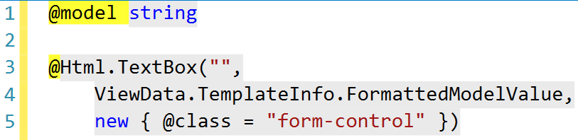
Helpers – Editor Templates
/Views/Shared/EditorTemplates/string.cshtml
Notes:
In this example we are overriding how a string is handled.
String.cshtml is added to the EditorTemplates folder in the Shared views folder. This is a standard convention of MVC.
We are using the TextBox HTML helper and adding the form-control class, that’s it.

Slide 14
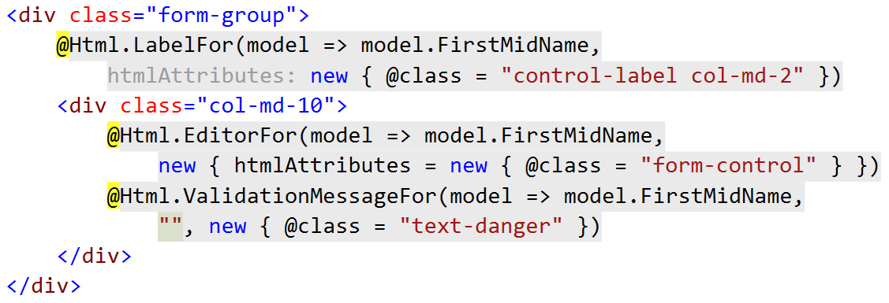
Helpers – Editor Templates (Before)
Notes:
This is the markup in the Student Create view before we created our editor template for strings.
This is simple markup, nothing complex about it. Except you need to remember to add that special form-control class for bootstrap every time you use the EditorFor helper.

Slide 15
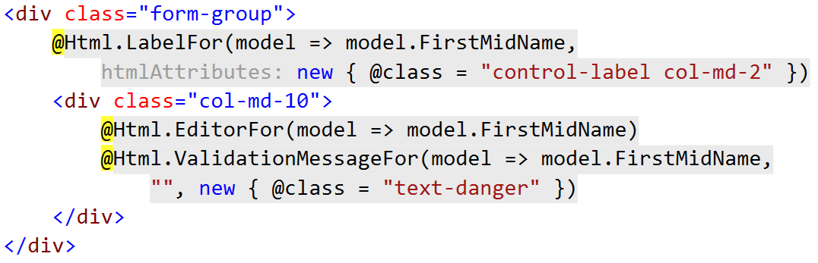
Helpers – Editor Templates (After)
Notes:
Now that we have an editor template in place for strings, we can drop manually adding the htmlAttributes. This cleans up our code and makes it consistent across the entire site.

Slide 16
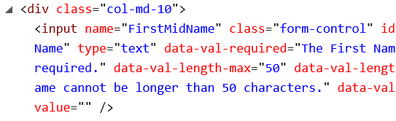
Helpers – Editor Templates
Notes:
And here is the output. Very similar to how we added validation.
You can continue to do that same for other data types and also for Display Templates / DisplayFor.

Slide 17
Helpers – Extensions
MVC
BOOTSTRAP
@Html.LabelFor(model => model.FirstName)
<label for=“FirstName">First Name</label>
@Html.BootstrapLabelFor(model => model.FirstName)
<label class="control-label" for=“FirstName">First Name</label>
Notes:
So that works well for editor templates, but there’s a lot more HTML helpers in MVC than just EditorFor.
Another nice feature of MVC is the ability to create new HTML Extensions for helpers beyond what you get out of the box.
1 – Here is LabelFor …
2 – And the markup it generates.
3 – We are going to start building up a Bootstrap Library of extensions that produce Bootstrap friendly output.
4 – In the case of a label, we want to add the class control-label to the output.

Slide 18

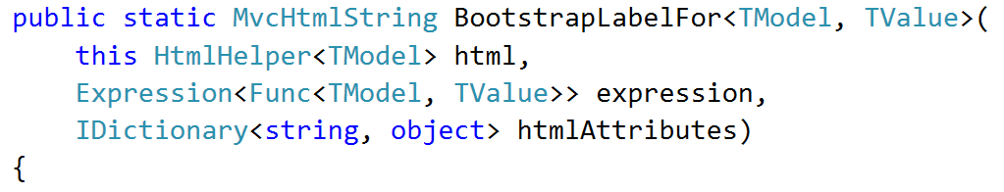
Helpers – Extensions
/Helpers/LabelExtensions.cs
Notes:
We start by adding a LabelExtensions class to a Helpers folder.
These are static classes with a very specific signature.

Slide 19
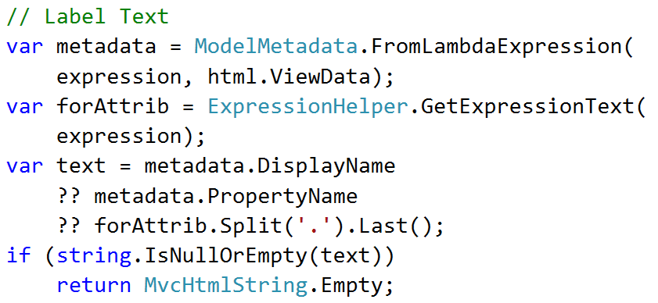
Helpers – Extensions
/Helpers/LabelExtensions.cs
Notes:
The first thing we need to do is get the label text, what do you want to appear in the label.
The passed in expression is the model item, so model.FirstName.
1 – We get the metadata from this expression.
2 – We get the for attribute to make it point to an input element for accessibility.
3 – We use the metadata’s display name as the text. This is the Data Attribute [DisplayName=“First Name”] that would appear above the model element.
4 - But we fall back to the property name if there is no display name data attribute set.
5 – Or if all else fails, we just strip out the expression value down to the final text after the period.
6 – And if all of this fails, we escape out with an empty string. This would happen when invalid model elements are passed.

Slide 20
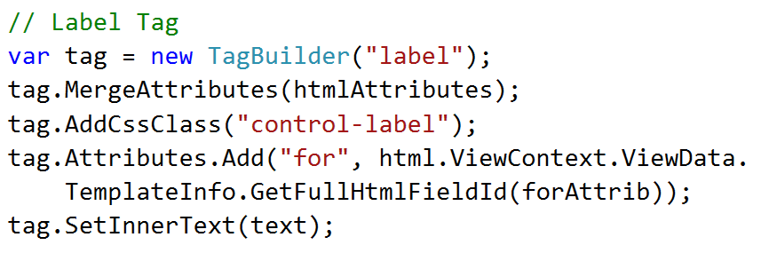
Helpers – Extensions
/Helpers/LabelExtesions.cs
Notes:
Next we build the label element.
We are using the TagBuilder instead of raw string manipulation.
If any additional htmlAttributes we passes in with the expression, we’ll merge those in.
We add the Bootstrap specific class.
We add the for attribute which point the label to its corresponding input value.
And finally add the label text from our previous block of code.

Slide 21

Helpers - Extensions
Notes:
To use the new label extension we go from
1 – The old MVC LabelFor helper where we applied the Bootstrap class manually.
2 – To the new BootstrapLabelFor. In this example I left an additional class being passed in that is not Bootstrap specific to the label but is Bootstrap specific for the grid layout it happens to be in.
3 – Either of these produces the exact same markup.
If we want to go farther and eliminate that positional col-md-2 class being passed in we can resort to our next method of extension ….

Slide 22

Helpers – Fluent Extensions
Notes:
Fluent extensions provide a way for you to extend your custom extensions by chaining a group of methods. This gives you more discoverability through IntelliSense and reduces Magic Strings.
1 – Here is an example of the different button types in Bootstrap. In addition to the different button classes they could also be standard event driven buttons or form submits.
2 – This is what we want to achieve through a Fluent API. You pass in the name of the button, chain the format, and then chain the type.

Slide 23
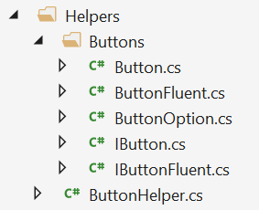
Helpers – Fluent Extensions
Notes:
This requires a bit more code than our previous extensions. An we’ll walk through each of these classes now.
This is going to seem like a lot of code coming at you in the next few slides, but remember there is a link at the end to download everything.

Slide 24
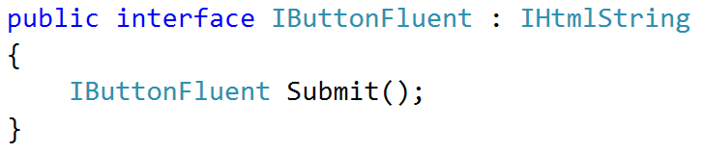
Helpers – Fluent Extensions
Notes:
I’ll leave the HTML helper on each of these slides as a reminder of what we are trying to rebuild.
1 - First we start at the end of the statement and create a Fluent interface class that extends the IHtmlString interface and adds a self referencing interface for the Submit type.

Slide 25
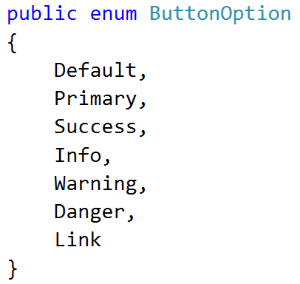
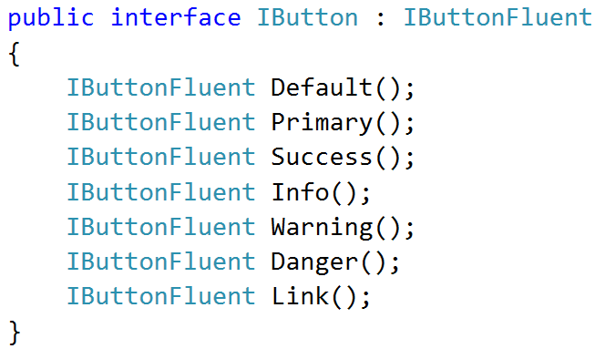
Helpers – Fluent Extensions
Notes:
Next, we move into the next part of the statement, the format of the button, in this case Default.
1 - We add an enumeration that has a value for each type of button format.
2 – We create an interface that extends the IButtonFluent interface we just made and adds a method for each type of button, Remember this is all in the name of IntelliSense and chaining methods to make creating buttons, which we will do a lot of, so a little more code now makes repetitive code later simpler.

Slide 26
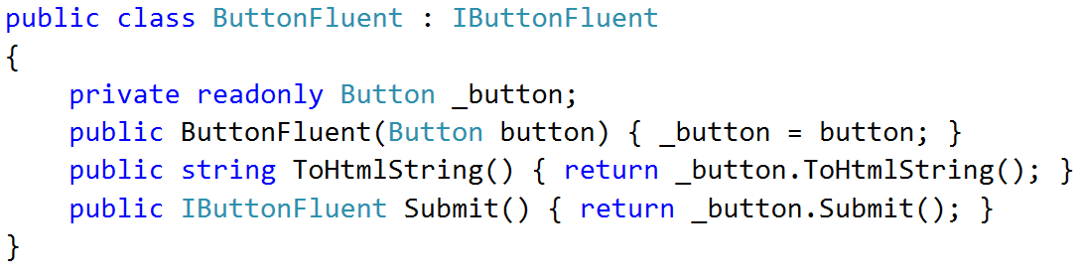
Helpers – Fluent Extensions
Notes:
Now we can implement the Fluent version of a button.
We wrap a (to be created) button class.
The constructor sets the reference to the button.
We implement the ToHtmlString method to simply call the ToHtmlString on the button class.
And we add the Submit type.

Slide 27

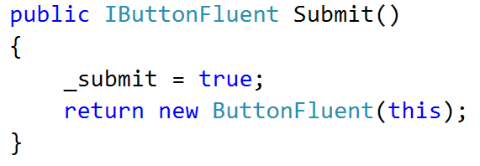
Helpers – Fluent Extensions
Notes:
Now we can get to implementing the actual button class that does more than just pass things around for our Fluent interface.
1 – We start my implementing the Submit type. If you chain in the Submit method, it sets an local variable to true. And then it returns a fluent button to make chaining work.

Slide 28
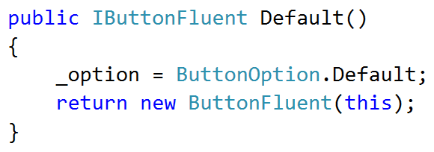
Helpers – Fluent Extensions
Notes:
Now we add the Default formatting method. It’s very similar to the Submit method. When we chain in Default we set a local variable to the default formatting option and then return a fluent button for chaining.
We would repeat this set of code for each formatting option: primary, success, info, warning, danger and link.

Slide 29
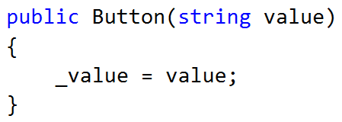
Helpers – Fluent Extensions
Notes:
No we make our way up the chain to the constructor in which all we need to do is save the text to a local variable.

Slide 30
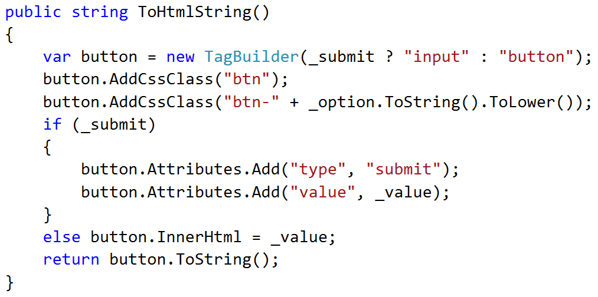
Helpers – Fluent Extensions
Notes:
Finally in the button class we implement the ToHtmlString which generates the markup based on all the chained methods we used.
We create a tag using the TagBuilder class like before and start with button unless Submit() was called in the chain.
We add the Bootstrap btn class.
We add the Bootstrap btn formatting class based on which format method was called. For example, Default.
Then if the submit button was added to the chain, we set the type attribute to submit and text passed into the constructor to the value attribute. In our example, this is Create.
If the submit method was not in the chain, then this is a standard button and we just need to set the inner html to the constructor value.
And finally send out the string generated by the TagBuilder.

Slide 31
Helpers – Fluent Extensions
Notes:
Finally what we end up with this the following output:
1 – Create constructor maps to the value attribute.
2 – The Default method adds the btn-default class.
3 – The Submit button adds the submit type and create an input element.

Slide 32
Validation
Setup
Validation
Helpers
Templates
Themes
Third Party Resources
Notes:
So, we made it though helpers. Assuming you are familiar with bootstrap and all the options it adds, you can start to see where you will be building up a library of helpers as you go. That’s the recommendation I would have rather than taking a big bang upfront approach.
On to Templates …
MVC has lots of scaffolding in place to create views. You can override those defaults to create your own templates based on Bootstrap classes and your new extensions.

Slide 33
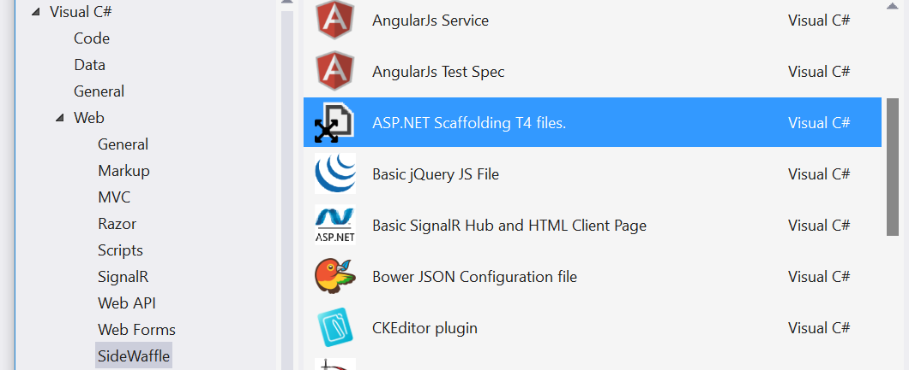
Templates - SideWaffle
Notes:
The easiest way to do this is to download the SideWaffle extension for Visual Studio. Which can be found at sidewaffle.com.
It adds a new folder of templates under Web. The item you want to select it the ASP.NET Scaffolding T4 files.

Slide 34
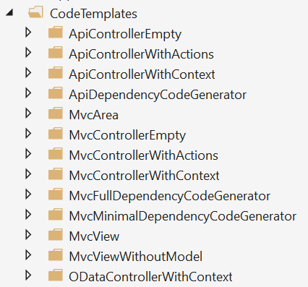
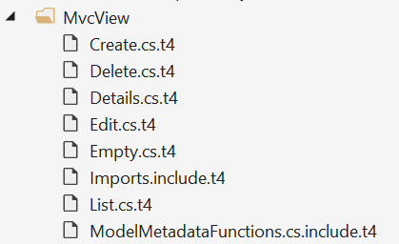
Templates - SideWaffle
Notes:
This will add a folder full of templates to your project.
The ones we are interested in are under CodeTemplates\MvcView.
If you have ever added a view in MVC these names will look very familiar….

Slide 35
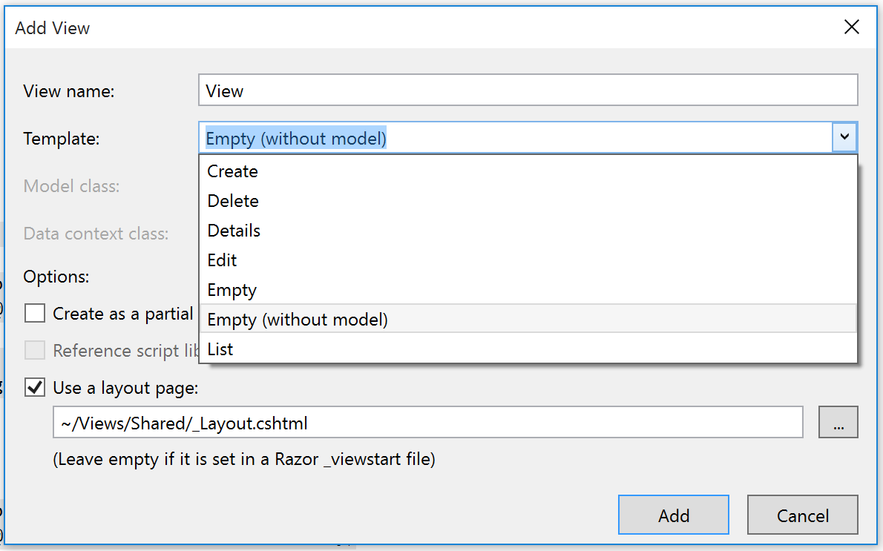
Templates – Add a View
Notes:
They map to the names in the Templates list.

Slide 36
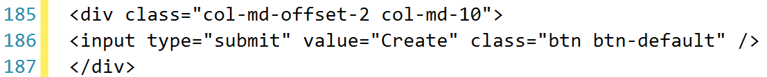
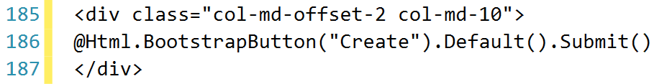
Templates – Create.cs.t4
Notes:
Editing these is very simple, just find the original markup you want to replace and change it.
In this example we are replacing the hard coded HTML on line 186 with our new Fluent Bootstrap button extension.
So as you come up with a look and feel for your application instead of the MVC defaults and with all your new Bootstrap extensions, you can make it much easy to scaffold new views that match.
So in theory, this is a lot easier than all those helpers, but this really design work at this point, which brings me to the next section ….

Slide 37
Validation
Setup
Validation
Helpers
Templates
Themes
Third Party Resources
Notes:
You are not a designer and you don’t want your site looking like the ASP.NET default design.
That’s where Bootstrap themes build by other designers can save you.

Slide 38
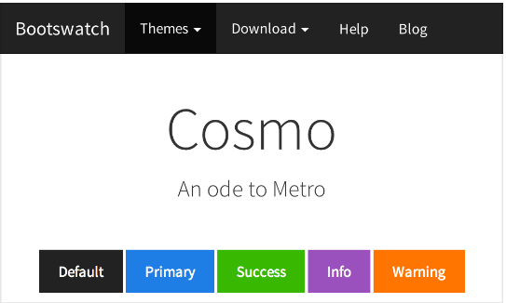
Themes - Basic
http://bootswatch.com/
Replace bootstrap.css
Notes:
The most basic of themes can be found for free at bootswatch.com.
Here we are looking at the Cosmo theme that “tries to capture” the Windows look and feel.
All you need to do is download the bootstrap.css file and replace the default one in your site.
There is nothing else to do, so this is super easy.

Slide 39


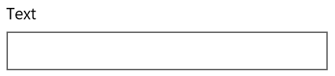



Themes - Advanced
http://winstrap.azurewebsites.net/
Add winstrap.css
New fonts
New images
New controls
Notes:
The next step up would be a more advanced template that extends the look and feel of Bootstrap.
In this example we are looking at a Bootstrap theme developed by Microsoft to more accurately capture the Modern Design Language for Windows.
In this case you need to add the winstrap.css file in addition to the bootstrap.css file. You also get a bunch of new Windows fonts, images and even some new controls.
But there is still nothing more you need to do to integrate with MVC other than create extensions like we have been doing, but a but more tailored to the theme.
In the case of Winstrap the first thing we found was that it was based on a 24 column layout instead of the default 12 column layout.

Slide 40
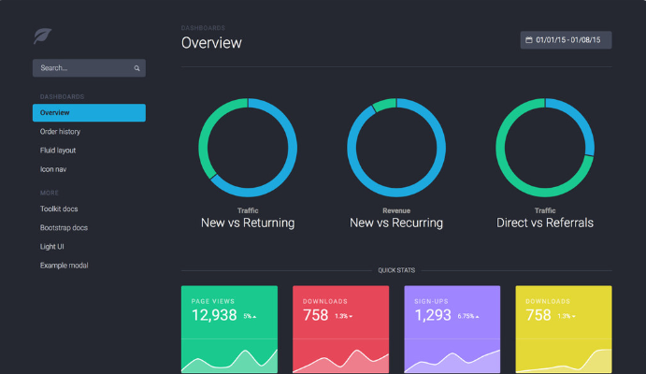
Themes - Complete
http://themes.getbootstrap.com/
https://wrapbootstrap.com/
Notes:
You may want to grab a theme that does more than just update Bootstrap look and feel. You may want an entire site designed in Bootstrap for you.
You can get these complete themes from places such as themes.getbootstrap.com which are official paid themes from the Bootstrap team, or wrapbootstrap.com which offers A LOT more paid themes from third parties.
So let’s look at what it takes to integrate these.

Slide 41
Themes - Integration
Re-map folders – CSS, JavaScript and Fonts.
Integrate the master layout into _Layout.
Pages become Controllers and Views.
Replace JavaScript libraries with NuGet or Bower.
Check for MVC versions!
Notes:
1 – Start by re-mapping the basic folders to the MVC structure or vice versa.
2 – Look of the master layout of the template (header, sidebar, footer, etc.) and slice them up into the _Layout shared view.
3 – Convert HTML pages within the downloaded theme to controllers and matching views.
4 – And finally replace the JavaScript libraries the theme is using with NuGet or Bower to make it easier to update. That last one is optional if you are buying a theme that is regularly updated and you want to stay in sync with the designer.
Now you can start integrating your custom MVC helpers as you go.
Also, make sure you look for themes that already have MVC versions available, let someone do the work for you. Quite a few of the top themes have MVC versions.

Slide 42
Validation
Setup
Validation
Helpers
Templates
Themes
Third Party Resources
Notes:
We’re in the home stretch now. Our last section is third party resources to help you out.

Slide 43
Resources – Paged List
X.PagedList (Free) - https://github.com/ernado-x/X.PagedList
Fork of PagedList.MVC
Bootstrap Layouts
@Html.PagedListPager( (IPagedList)ViewBag.OnePageOfProducts, page => Url.Action("Index", new { page }) )
Notes:
PagedList.MVC is a very popular, free add-on that makes it easy to create server side paged tables of data.
It has recently been forked into X.PagedList.
It’s easy to use and has options to make it use Bootstraps build in paging indicators.

Slide 44
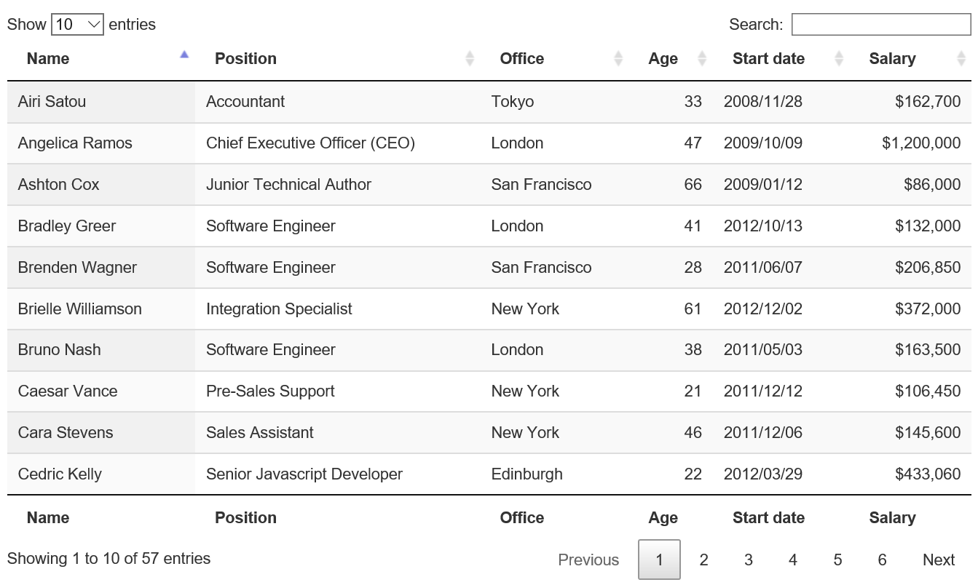
Resources – Tables
jQuery DataTables (Free) http://www.datatables.net/
$(document).ready(function(){
$('#myTable').DataTable();
});
Notes:
If you want to take it a step further into a more complete tabular data solution, you can turn to jQuery DataTables.
It has all kinds of options for paging, sorting, filtering, searching, on and on and on.
It’s a free alternative to the big vendors paid grids.
And it also comes Bootstrap ready.

Slide 45
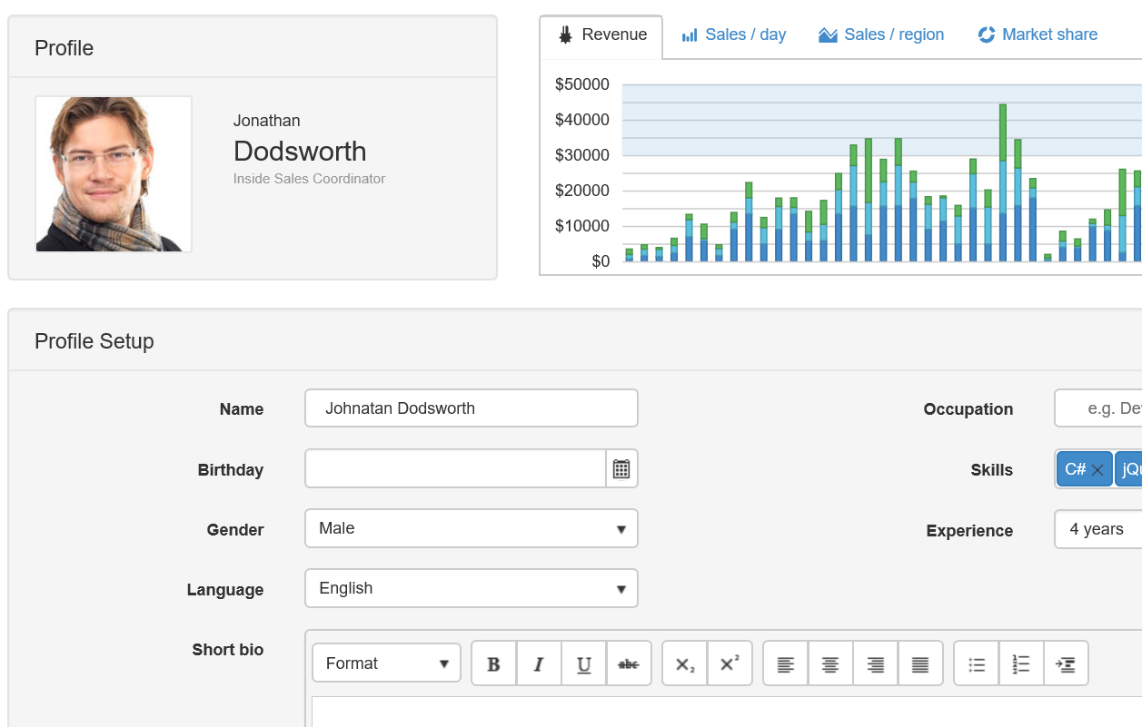
Resources – Suites
Kendo UI (Free through $$$)
http://www.telerik.com/kendo-ui
Notes:
If you are going the paid route to get enterprise level support, you’ll find the big vendors like Telerik have also made their control suite Bootstrap ready.
Kendo has a free version, but if you want some of the controls like the Grid and TreeView these will cost you per developer,
But you can see the trend here. Bootstrap is VERY popular and third parties need to support it to compete.

Slide 46
Resources – Fluent Wrapper
TwitterBootstrapMVC ($60 personal, $200 commercial)
https://www.twitterbootstrapmvc.com/
Notes:
Finally, if you liked the Fluent API approach I showed earlier and you have some money to spend, make sure you check out TwitterBootstrapMVC.
It adds a Fluent API for you.

Slide 47
Resources – Fluent Wrapper
<form action="/" class="form-horizontal" method="post"> <div class="form-group"> <label class="control-label col-sm-3 col-md-2" for="Email"> Email <span class="required">*</span> </label> <div class="col-sm-9 col-md-10"> <input class="form-control" id="Email" name="Email" type="text" value=""> <span class="help-inline"> <span class="field-validation-valid" data-valmsg-for="Email"></span> </span> </div> </div> <div class="form-group"> <label class="control-label col-sm-3 col-md-2" for="Password"> Password <span class="required">*</span> </label> <div class="col-sm-9 col-md-10"> <input class="form-control" id="Password" name="Password" type="text" value=""> <span class="help-inline"> <span class="field-validation-valid" data-valmsg-for="Password"></span> </span> </div> </div> <div class="form-group"> <div class="control-label col-sm-3 col-md-2"></div> <div class="col-sm-9 col-md-10"> <div class="checkbox"> <label for="RememberMe"> <input id="RememberMe" name="RememberMe" type="checkbox" value="true"> <input name="RememberMe" type="hidden" value="false"> Remember Me <span class="required">*</span> <span class="help-inline"> <span class="field-validation-valid" data-valmsg-for="RememberMe"></span> </span> </label> </div> </div> </div> <div class="form-group"> <span class="control-label col-sm-3 col-md-2"></span> <div class="col-sm-9 col-md-10"> <button class="btn-default btn" type="submit">Submit</button> </div> </div> </form>
@using (var f = Html.Bootstrap().Begin( new Form().LabelWidthMd(2).LabelWidthSm(3))) { @f.FormGroup().TextBoxFor(m => m.Email) @f.FormGroup().TextBoxFor(m => m.Password) @f.FormGroup().CheckBoxFor(m => m.RememberMe) @f.FormGroup().CustomControls( Html.Bootstrap().SubmitButton() ) }
Notes:
Check out this example.
I know it almost impossible to read on this slide. But look at the right side and how much that Bootstrap markup gets reduced to.
This might be a little overkill on the Fluent side, but its worth checking out.
Just remember, when you start hitting third party advanced themes or paid themes, you are going to have to do some work here to integrate the two.
First, update the themes markup to use these Bootstrap helpers, and second extend these Bootstrap helpers as necessary to pick any custom missing pieces.

Slide 48
Summary
Setup
Validation
Helpers
Templates
Themes
Third Party Resources
Notes:
1 – Setup is easy, its built in by default or available as NuGet, Bower, etc.
2 – Always start with a custom validation JavaScript file to get the two validation styles working together.
3 – Helpers are where you will spend a lot of time building up integration with Bootstrap, you can go as extensive and deep as you want. TwitterBootstrapMVC is a good addon to cut down on this effort if you are using Bootstrap and not something else like Foundation.
4 – Update the default view templates you use to your own look and feel and your custom helpers so you get a big headstart on each view you create and your not typing the same boilerplate markup over and over.
5 – If your not a designer, make sure you at least to grab something other than the default theme, that can go a long way to user acceptance and perception.
6 – There are lots of third party resources for Bootstrap out there and many of them have MVC integration. And if they don’t, now you have enough knowledge to add that integration and contribute back to those resources.

Slide 49
Materials
Scott Kuhl - @scottkuhl
scott@kuhl.ws
http://1drv.ms/1LNDIqL
Notes:
And that brings us to the end.
Once again, here is my contact information and the download link for the content as big as I can display it.

